Slide 1

Space Monsters
Haomei Liu
Denny Shen

Slide 2

Project Proposal & Introduction
Attempt of reproducing the classic arcade game, ‘space invaders’.
Player will be able to control a tank through FPGA by moving the tank horizontally at the bottom of the screen with button LEFT and RIGHT, and trying to take out all of the monsters with button UP.

Slide 3
vga_top.v
display_controller.v
space_monsters_sm.v
block_controller.v
debounce.v
Notes:
The vga_top file links all the design with the nexys4 board. Display controller alone handles syncing between the program and the monitor. Space monsters sm is our main state machine that manages general logic of how the game runs. The main state machine talks with block controller.v, which handles more detailed logic about specific objects including the tank, monsters, and bullets. Debounce.v is used as a tool in the design to process button press.

Slide 4
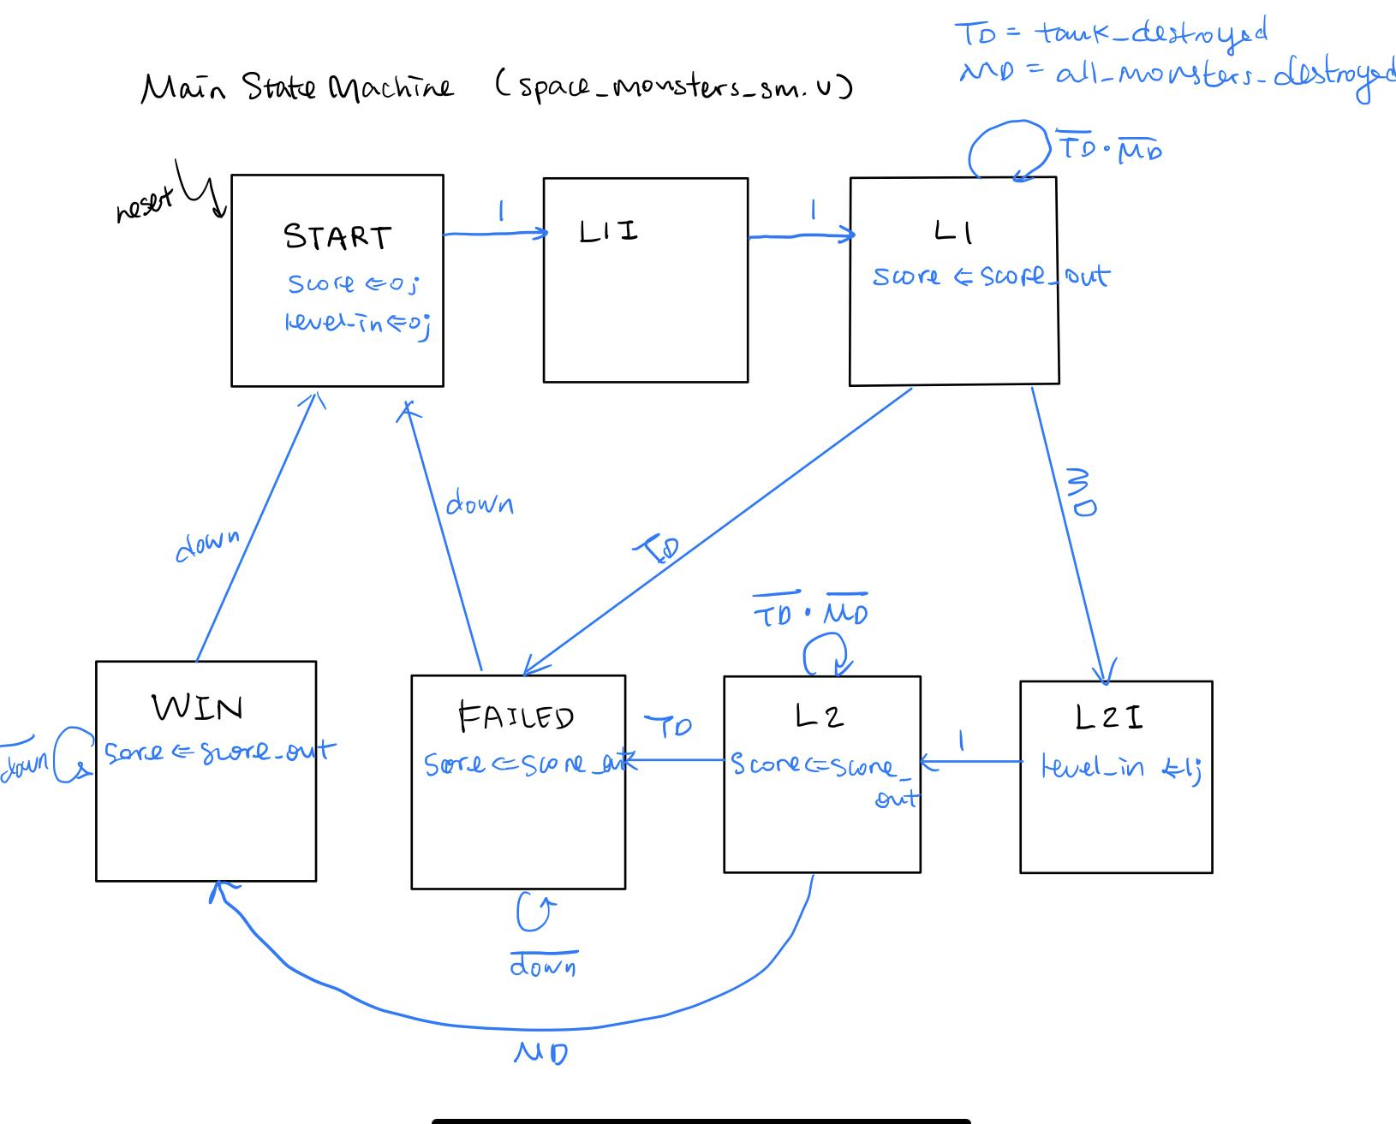
State Machine
Notes:
This is our main state diagram. As mentioned it does not involve design for specific objects, it only describes the general flow of the game. With a reset button, we enter the START state, clearing score and set level to 0. It then goes to L1I, which is added for clock consideration. In the next clk cycle we enter the level 1 state, receive score output from the block controller module. Two state transition conditions, tank destroyed and all monsters destroyed, are also output sent from the controller module. If tank destroyed flag is raised, we enter the FAILED state. If all monsters are destroyed, we enter Level 2 initiation and set level to 1. Similar logic for Level 2 state, output from controller module decides state transitions. Only difference is that this time if all monsters are destroyed, we would enter WIN state. We stay in WIN or FAILED state until the user press down button, which takes us back to the START state.

Slide 5
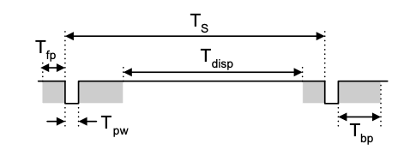
Clock
clk - 100MHz
Display clock - 25MHz (vga display)
Move_clk - DIV_CLK[19] - 95.4Hz (state machine)
ssdscan_clk = DIV_CLK[19:18] (ssd in top file)
Notes:
Clk - timescale defined on the very top
Display clk - pixel clk based on nexys4’s timing specification, generated from clk divider, dividing twice
Indicated by the waveform, hCount and vCount are calculated based on display time
Move clk also generated by simple clk divider. Considering that user interacts with the design in a much slower rate than the clock frequency, move_clk serves as a slower clk to drive the movement of objects on the vga screen and is used in state machine.

Slide 6
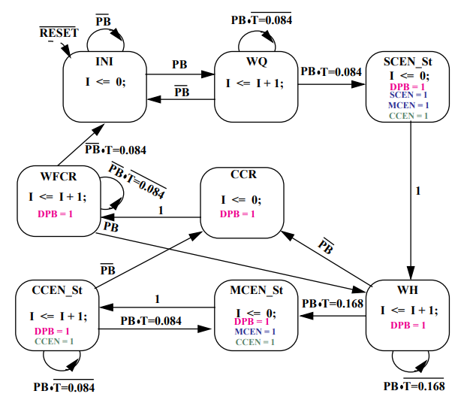
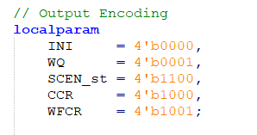
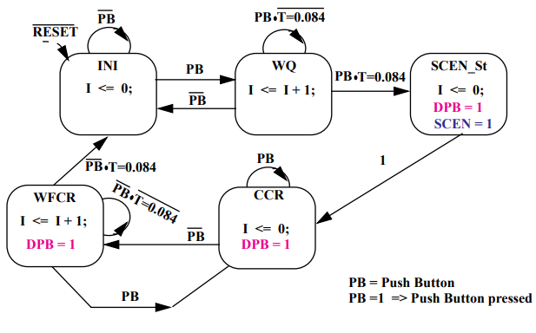
Button Debounce
Press-to-Fire
SCEN: single-clock wide pulse
Hold-to-Fire
MCEN: multiple clock enable

Slide 7

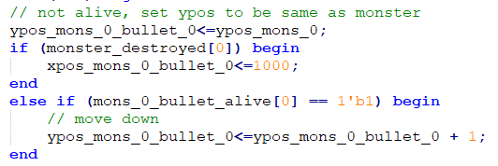
Bullet Movement
Start
Reset, Delete, and Move

Slide 8
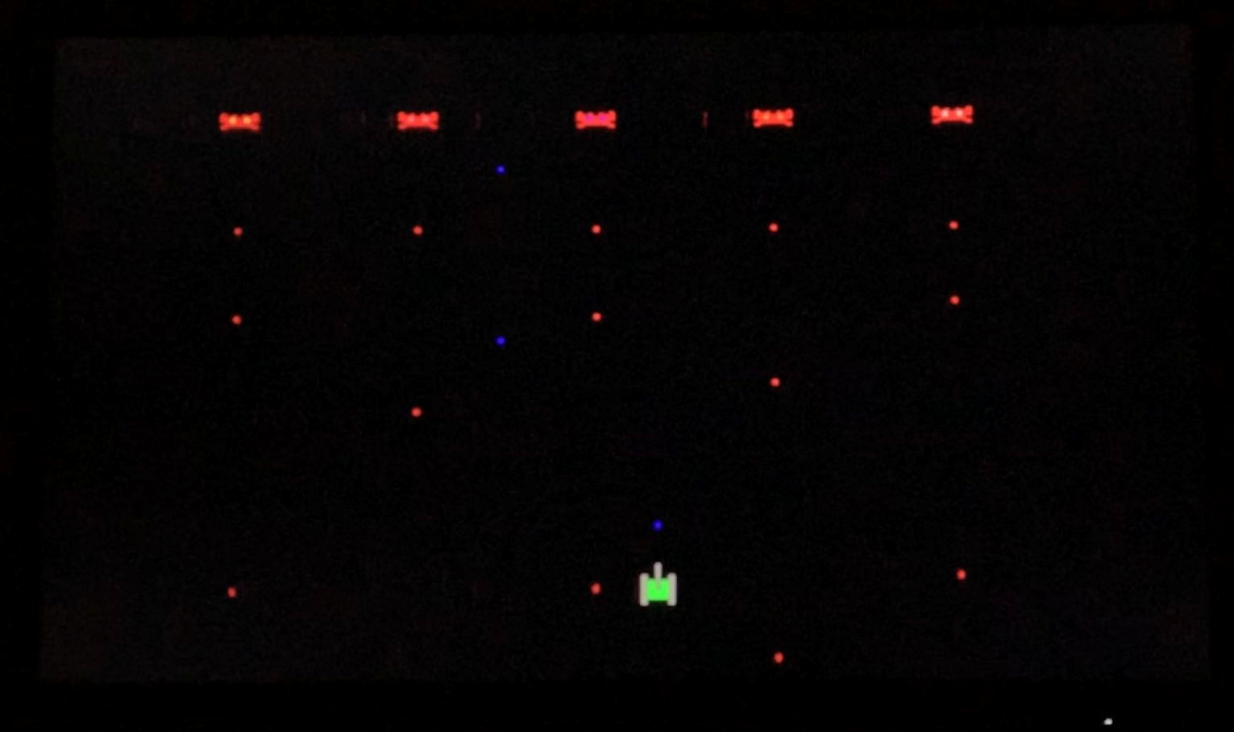
Game Screenshot & Demo

Slide 9
Thank You!
Q&A

